Slide 1
Design Project:
Reservation System
Joshua Skotarczak
12/04/2022

Slide 2
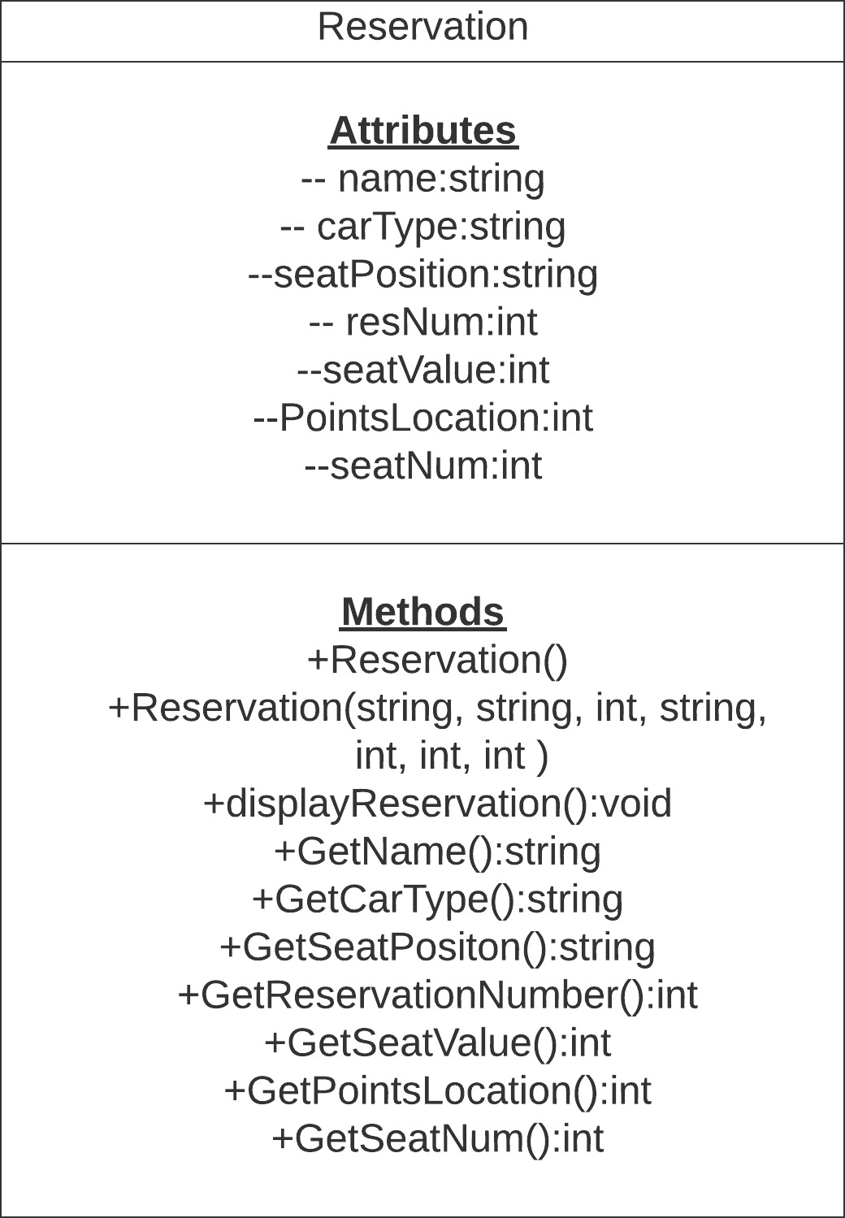
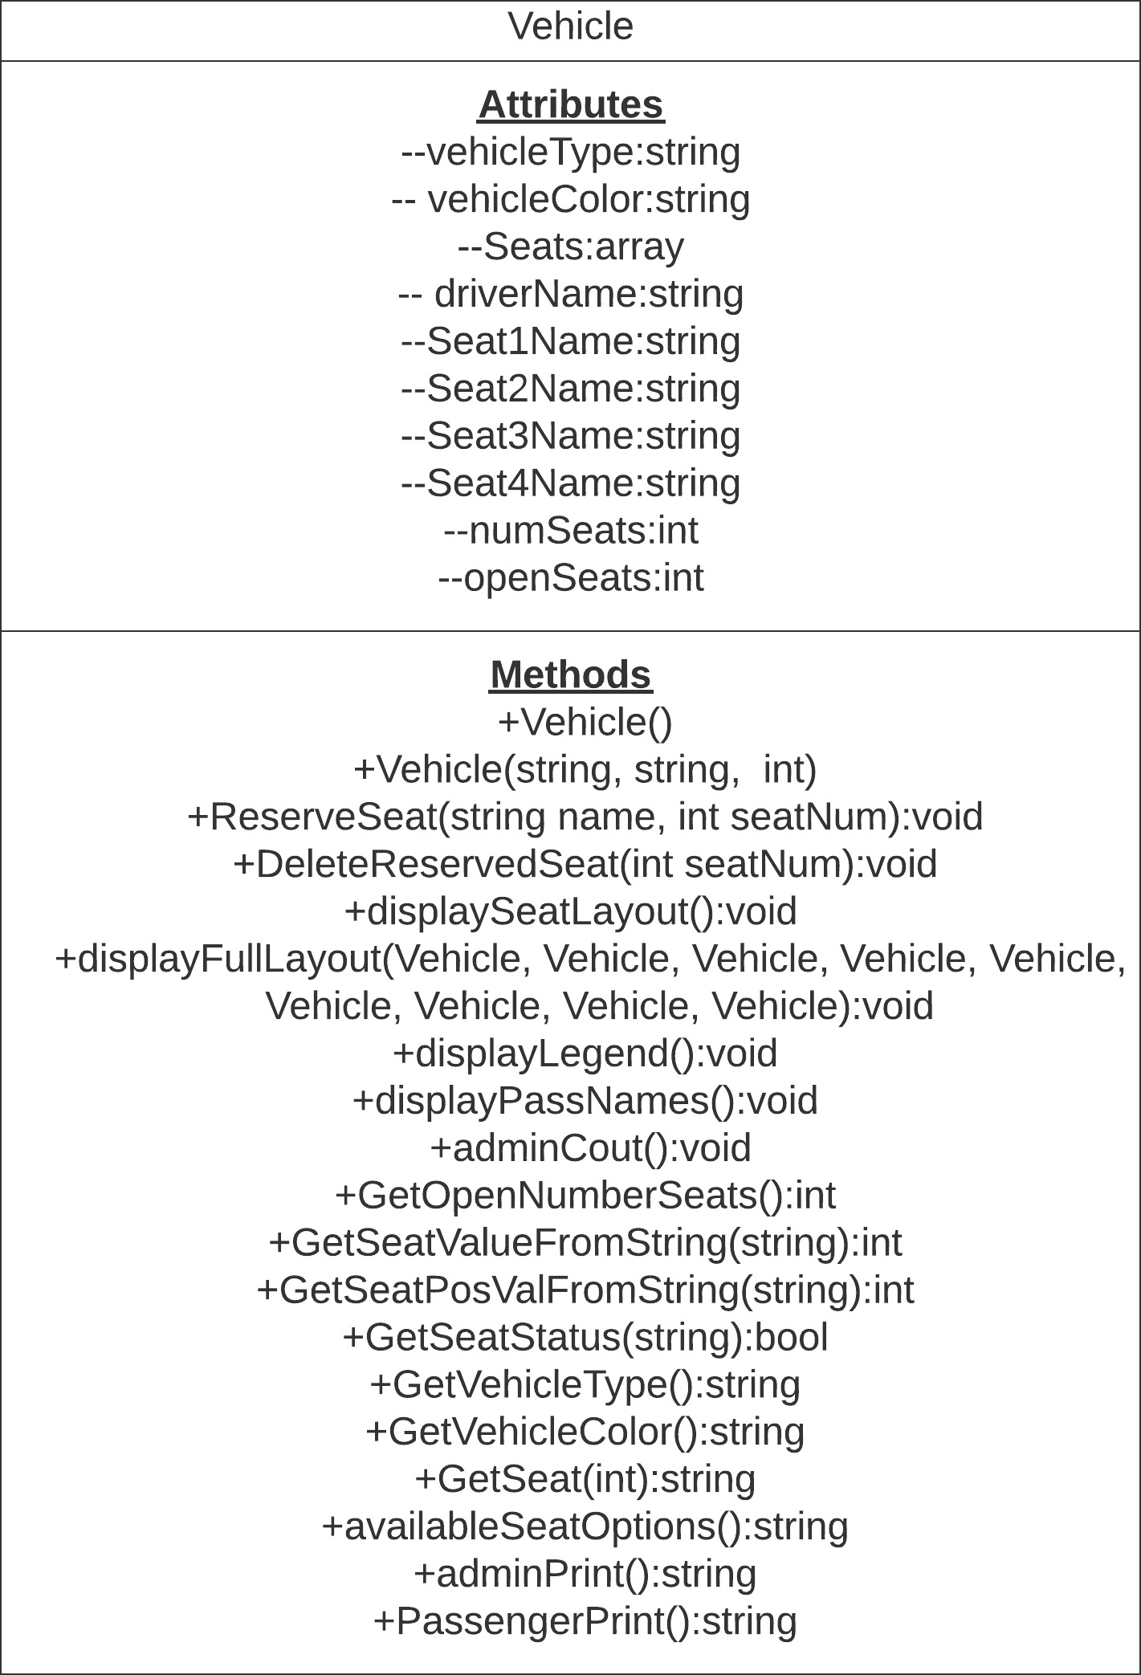
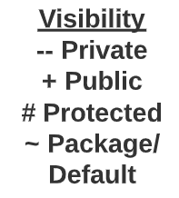
UML Diagrams
Reservation Class
Vehicle Class

Slide 3


STL Library Containers
List of the Reservation Class to keep all reservations.
Arrays – Used to keep all names, seat credits, and what reservation numbers inside of main.
Array – Used inside of the Vehicle Class to keep seat diagram layout characters.
Example: "5" or "X".
List of Reservation Class
Arrays In Main
Array In Vehicle Class Holds Seat Display Characters

Slide 4
Notable Features in our Design:
Minimal Crashing: Program is designed to catch edge case inputs and return to the default menu instead of crashing
Exiting At Any Time: Users will be able to exit to the main menu in the middle of input prompts* by entering ‘-1’
Live Seat Diagrams: When in the creating or modifying reservation state, a seating diagram will show if a seat is taken and all passenger names in that vehicle
*If a user exists while in the modify state, this will delete the reservation in order to allow other users a chance of reserving that spot

Slide 5
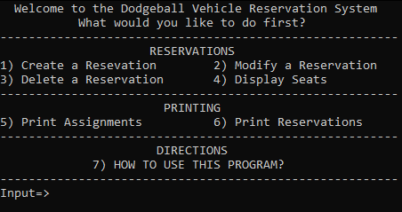
User Interface
This is the default menu prompt
Users can:
Create, modify, and delete reservations
Display and print assignments to text files
There is a tutorial option for more in-depth descriptions of each option of the program (7)

Slide 6


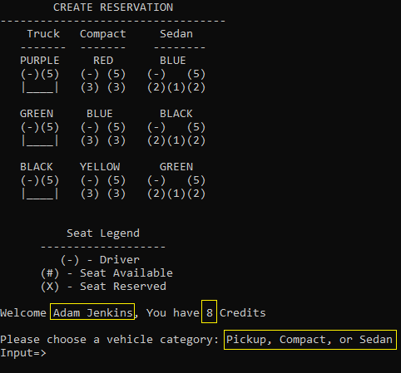
Creating a Reservation (1)
Example Input: Adam Jenkins
This function checks if a user is on the team or not
Function also checks if user is a driver
If on the team and not a driver, the name and credits will be shown
Inputs are case sensitive; Incorrect inputs prompt for new input
Example Input: A non-member is entered

Slide 7
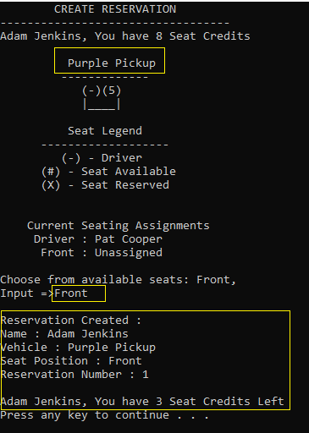
Creating a Reservation (cont’d)
Creating a Reservation requires inputs of:
Vehicle Type, Vehicle Color, and Seat Position
Once all requirements are filled, the program prints a summary of the reservation
A seat map is shown and is updated after every reservation
A reservation number is given, and the user’s credits are updated
For window back seat Inputs for common positions chooses randomly

Slide 8


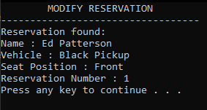
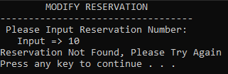
Modifying a Reservation(2)
This function requires at least one existing reservation.
If no reservations are found, an error message will print and return to the main menu
Users can modify an existing reservation if they input the reservation number
Modifying will bring users back to the reservation screen to reselect a seat
A user’s credits are restored in the modify state. This allows them to choose a seat with their initial amount of credits
No Reservations
Modifying Reservation Number 1
A Reservation Is Not Found
A Reservation Is Found

Slide 9

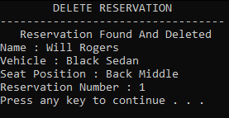
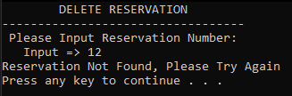
Deleting a Reservation (3)
Delete Reservation 1
Like the modifying option, deleting a reservation also requires at least one existing reservation
Users can delete a reservation by inputting a reservation number
Users will get their credits back if a reservation is deleted
If no reservations are found, an error message will print and return to the main menu
Prompt for a Successful Deletion
Prompt for Reservation Not Found

Slide 10
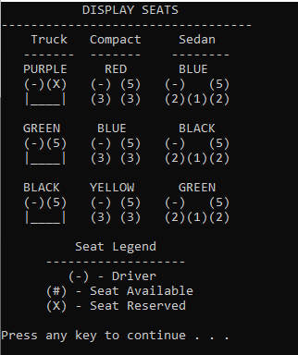
Display Seats (4)
Displays an updating diagram of all seat positions
After a reservation is made, it will fill a seat with a ‘X’ that will reflect on this display
‘#’ represents a number, or an available seat
The number represents the credits required to reserve that seat
Display Seat Layout Of All Vehicles

Slide 11
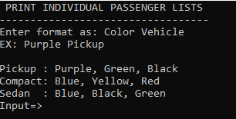
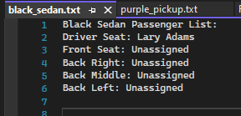
Print Assignments (5)
Printing assignments require a user to select a specific vehicle
A list of all passengers (including the driver) will be printed to a text document of that name
ex) black_sedan.txt
Empty seats will show as “unassigned”
User Must Choose From Valid Vehicles
black_sedan.txt

Slide 12
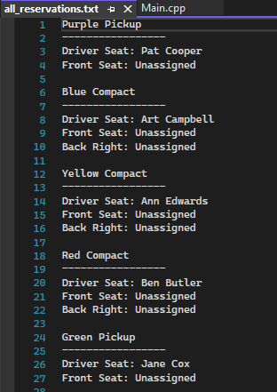
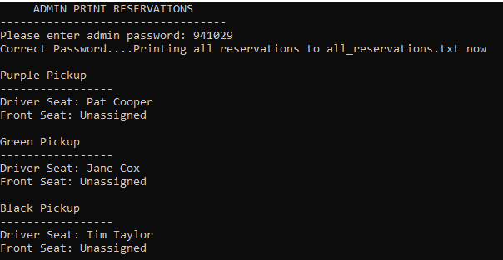
Admin Print (6)
The admin print feature prints a complete passenger list for the six vehicles to “all_reservations.txt”
This print feature is the same as the previous function but prints all vehicles to one text file
However, this feature requires an admin password which is hardcoded. Users have 3 attempts before returning to main menu
The password is: 941029
Snippet of Print in Terminal Window

Slide 13
Questions?

